Slide 1
Communicative English Faculty – Dr. Kiran Magavi
Introduction to Communication & process

Slide 2
Root of the term – communication
Communication is as old as the human race.
Several communications scholars have stated that the word "communication" is derived from the Latin verb "communicare" which means " to make common" or " to share".
It is also believed to have been based on a Latin word, "cummunis", which means to communicate and share, to impart a piece of information, a message, an idea or concept.

Slide 3
Expanse or spread of communication
When a baby sees its mother’s face for the first time, communication happens.
When someone steps out onto a beach and the air touches his nose and the smell of the ocean comes into his mind, communication happens.
When a Parliament passes and the President signs a new bill, communication happens.
When a computer in Delhi calls up a computer in Tokyo and transmits a message, communication happens.

Slide 4
Points to ponder
Communication is the modus operandi of social and commercial intercourse.
It is communication, which gets the world going. It is the lifeblood of any organization.
It is the ability of mankind to communicate across barriers and beyond boundaries that has ushered the progress of mankind.
It is the ability of fostering speedy and effective communication around the world, which has shrunk the world and made ‘globalization’ a reality.
Communication is at once the cause and the consequence of a powerful world.

Slide 5
The need for communication
Man is a social being. As a member of society he has to constantly interact with his fellow beings.
He has emotions, feelings, likes and dislikes. He has to give vent to all these.
He needs to convey and let others know what he feels. In other words, whatever be the environment in which a person is placed, he has to build links, establish relationships and have connections.
The need for communication arises from man’s desire to express himself in a meaningful manner.

Slide 6
Reality check
According to researchers,
A normal person spends 50%-80% of waking hours in communication. Of this:
About 45% is spent in listening;
About 30% is spent in speaking;
About 15% is spent in reading; and
About 10% is spent in writing.

Slide 7
Factors responsible for growing importance of communication
Global Business Environment
Large-Scale Operations
Technological Advancement
Role of Information
Need for Better Human Relations
Increasing Social Role of modern businesses
Change in management style of business houses – participative
Diverse cultures and languages across the globe

Slide 8
Evolution of communication
The art of communication is as old as civilization.
The art of communication, in fact, is older than the written word or even the spoken word.
Man learnt to communicate even before he learnt to speak, read and write. And communication is not unique to human beings alone.
Communication pervades the animal world as well. Birds and animals also communicate. The sounds they make do carry meanings.
Much before he learnt to speak, man had learnt to express himself through sounds, gestures and actions.

Slide 9
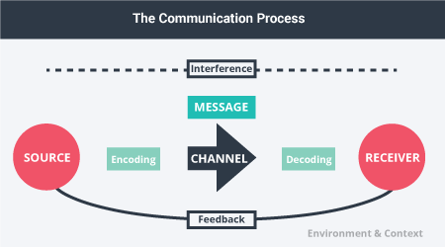
Process of communication

Slide 10
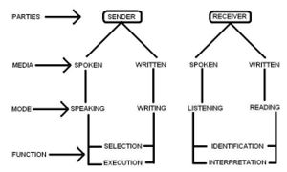

Slide 11
